Slide 1
Spatial Distribution of Diatoms in the Northern Atlantic Ocean
Andrea Jaegge

Slide 2
Diatoms
20% of global carbon fixation
40% of marine primary productivity
Major roll in biogeochemical cycles
Form the base of aquatic food webs

Slide 3
Northern Atlantic Ocean (NAO)
Diverse seasonal bloom patterns
Spring, summer, & fall
Positive and negative correlations found with SST depending on the region

Slide 4
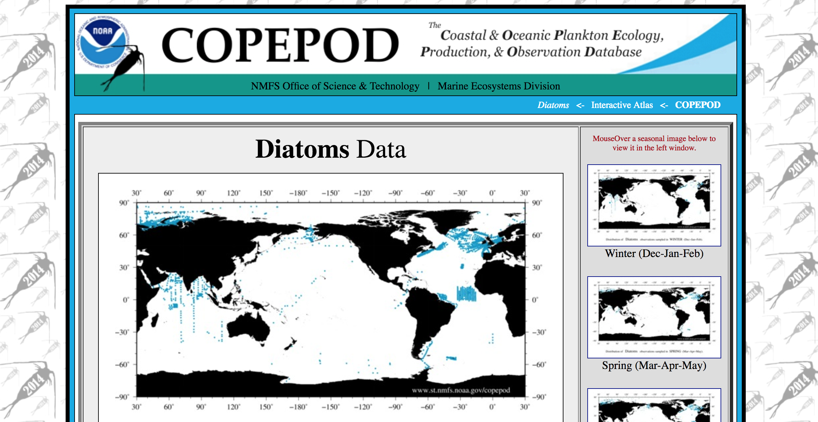
Diatom Data
1963-1999
Date/location
#cells/ ml
Genus

Slide 5
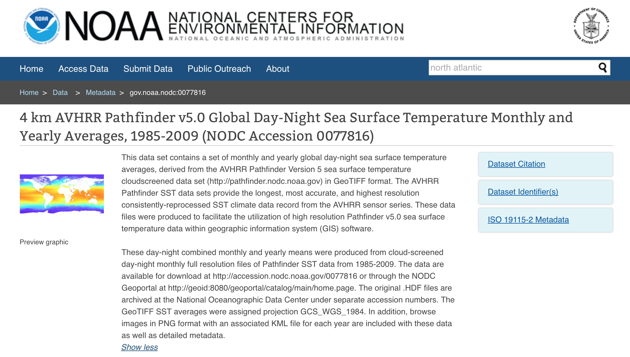
SST
1985-2009
Monthly SST raster files
Global

Slide 6
Methods
Data processed in R with GitHub
Projected using North Pole Lambert Equal Area
Created a polygon of the study site in the NAO and clipped sites outside of this location
Determined that spatial distribution was statistically significant using Moran’s I test
Ran 3 predictive kriging models & chose the best fit
Exponential model type based error metrics

Slide 8
Methods
Model Builder used to clip SST rasters to NAO & build pyramids
Raster calculator to determine mean SST per cell for the year
Raster to points
Spatial join with the diatom data
Ran a geographically weighted regression

Slide 10
Ways to improve
Incorporate other environmental parameters
Copepod grazing data
Smaller time scale

Slide 11
Questions?

